Slide 1
2020 Forces of Change
And How The Covid-19 Pandemic is Impacting Them Updated: April 2020

Slide 2
Forces of Change Impacting the Human Experience in 2020: A COVID-19 Update
Examining Forces of Change Through the Lens of Tension
As we enter a new decade, we see a number of unique and powerful forces of change (whether cultural, human, media or technology) that are poised to have an undeniable impact on the human experience in the decade ahead. And without question, one of the greatest forces our modern world has ever experienced is the global Covid-19 crisis, which is changing everything; how we live, work, play and connect with each other. In this updated report we consider how the pandemic is intersecting with and impacting the existing forces of change identified in early 2020.
This report examines forces of change through the lens of 11 core tensions, which we define as the friction that sits between brands and people (see right). Some of the changes will increase tension and pose even greater challenges to people and brands coming together. Conversely, some of the forces of change represent opportunities for brands to reduce the tension that gets in the way of them truly connecting with and satisfying people.
Interestingly, one immediate impact we have seen due to the global pandemic is the introduction of a new tension: People can’t find/buy you (Scarcity/Lack of Availability). As people pantry-load, panic-buy, and stock-up for the difficult times ahead, we see for the first time in the post-WW II age that one of the major tensions between People and Brands is simply not having product or service availability and people literally lacking the opportunity to buy or use the brand.
While our world is changing rapidly, we will continue to assess the impact of COVID-19 on people and brands. In the meantime, we hope this provides inspiration and insights on where we are today.
Starcom. The Human Experience Company.
In our work across virtually every category vertical and hundreds of brands, we have traditionally identified that there are fundamentally 11 sources of tension that cause friction between brands and people. Today, we are observing an additional tension:
Lack of Awareness
People don’t know about you
Lack of Understanding
People don’t get you
Indecision / Commitment Issues
People aren’t ready for you
Novelty Seeking
People want to try something new
Utility / Convenience
People don’t think you are worth the effort
Price / Value
People don’t think you are worth the cost
Inertia / Avoidance
People don’t want to change their habits or routines
Lack of Desire
People aren’t interested in you
Functional Issues
Your brand / product doesn’t do what people want it to
Unmet Expectations
People don’t think you are good enough
Lack of Trust
People don’t believe you
NEW Covid-19 Specific Tension
Scarcity/Lack of Availability
People can’t find you or buy you
Increasing Brand Tension
Decreasing Brand Tension

Slide 3
Table of Contents
Clear Opportunities For Brands To Reduce Tension With People
You Are What You Listen To: Audio Identity
The Rise of Self-Care & The Wellness Trojan Horse
Innovation Leapfrog Adoption
Technology Enables Our Laziness
Mixed: Possibility Of Both Reduced And Heightened Tension
Extreme Choices, Extreme Culture
Green Pressure & The Accelerating Expectation Gap
Smart Devices, Simple Things
Strong Risk Of Heightened Tension Between People And Brands
Achieving Scale in Our Fragmented World
DTC Changing the Price-Value Equation
Shifting Landscape, Shifting Vices
Fake Will Continue to Flourish
4 5
6
7 8
9
10
11
12
13
14
15
16
17

Slide 4
TENSION
Clear Opportunities for Brands to Reduce Tension with People
4

Slide 5
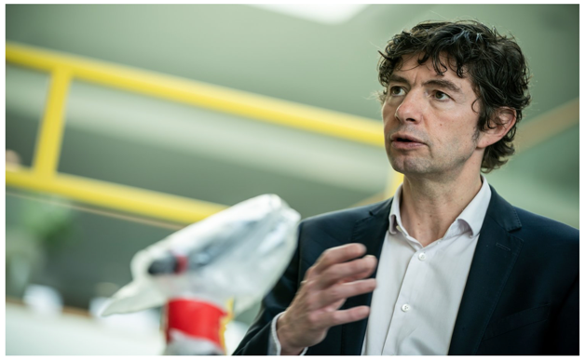
Categories Impacted:
All
You Are What You Listen To: Audio Identity
Audio as an entertainment format is experiencing a resurgence, offering brands new opportunities to connect with people. We’ve seen this force of change take hold in podcasts and new content consumption behaviors. Listening is on the rise as people want to experience their passions, connect with fellow podcast followers. A new adage emerges “You are what you listen to.”
This is a chance for brands to leverage the power of audio to reduce the tension of ‘People don’t get it/Lack of Understanding.’ Today, digital audio advertising encompasses streaming audio, podcast and smart speaker advertising opportunities.
Savvy brands and marketers are thinking about how to engage on this channel with frequency (strategically, no one-off’s) and build the brand’s user experience or story through music intelligence, mogos (musical logos), and audio brand identity.
COVID 19 Update: During the current global pandemic people are leaning into Audio formats even more significantly as they seek new avenues for entertainment, something to listen to while out walking, and reliable news sources which they are finding both on radio and via podcasts.
Visa is integrating sound as part of the brand experience by adding tones and haptic responses to their transaction ecosystem.
700,000
Currently more than
Tension Spectrum: People don’t get it/lack of understanding
active podcasts and 29 million episodes
'Das Coronavirus' Podcast Captivates Germany With Scientific Info On The Pandemic

Slide 6
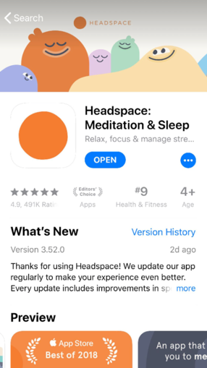
Categories Impacted:
All
The Rise of Self-Care & The Wellness Trojan Horse
In the 2020’s we will see more brands turn to self-care and wellness to grow brand relevance with people outside of their core demographic or extend their brand promise into adjacent categories.
A common tension brands face is that people don’t want to change their routine. With the rise of self-care, we are actually seeing this tension lessen as people make positive changes. As this force of change continues to take hold, more brands are seeing the potential in the wellness market.
It will become increasingly difficult to untangle where self-care, wellness and lifestyle brand intersect. Brands without their own wellness angle could find themselves under more scrutiny.
COVID 19 Update: During the Covid-19 crisis, self-care has become an interesting dynamic. Self-care practices like washing your hands, social distancing, and wearing PPE are surging. And emotional self-care is at everyone’s forefront with people focusing on new behaviors to help maintain sanity and emotional quality of life during these challenging times.
Miller Coors will launch Vizzy, a new hard seltzer with antioxidants, in 2020.
Headspace meditation app is offering free services as coronavirus anxiety rises.
22%+
Tension Spectrum: People don’t want to change routine/habit
of total income the average American spends on self care
Notes:
22% marketwatch
64% - US dscout research for CVS

Slide 7
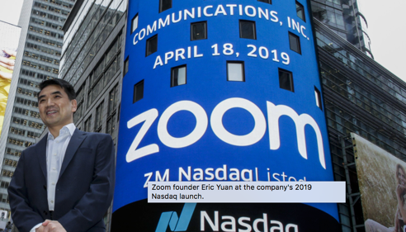
Categories Impacted:
Hardware Manufacturers, Technology, All
Innovation Leapfrogs Adoption
Indecision, commitment issues and people’s unwillingness to change are all common tensions that have plagued brands for decades (“People aren’t ready for it”). Brands have always grappled with how to accelerate peoples’ adoption of new things, but today, technology is forcing our hand.
With no choice, people are finding themselves in a connected home, autonomous driving car, wireless headphones or smart TV – simply because the old technology was put out of production.
New adoption curves, whether driven by manufacturers or extreme situations, will disrupt purchase cycles, force connectivity and drive new content behaviors that wouldn’t come naturally to many consumers. Whether we are ready for change or not, it’s here.
COVID-19 Update: The Covid-19 crisis is causing an interesting dichotomy in the development and adoption of new technology. On the one hand, technology companies like Apple and are dealing with delayed launches due to supply chain disruptions. On the other hand, the current environment is forcing rapid adoption of new technology platforms and behaviors as people adjust to working from home, e:learning, virtual “hangouts” and more.
Samsung does away with headphone jacks.
57%
Tension Spectrum: People aren’t ready for it
Zoom becomes the defining app of the Coronavirus era.
People think that autonomous cars will be a threat
Notes:
https://techcrunch.com/2020/01/02/after-2019s-reality-check-whats-ahead-for-driverless-cars-in-2020/
https://www.roboticsbusinessreview.com/unmanned/unmanned-ground/infographic-hopes-and-fears-around-self-driving-cars/

Slide 8
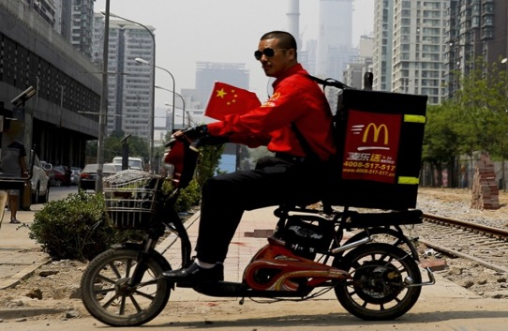
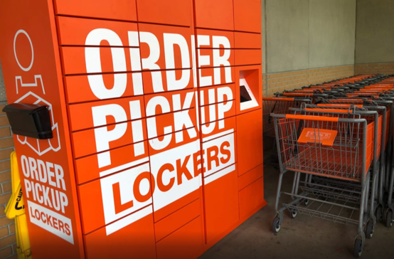
Categories Impacted:
CPG, Technology, Automotive, Insurance Providers
Technology Enables our Laziness (and Survival)
As human beings, we are inherently lazy. Our basic nature is to take the path of least resistance and to favor the smallest amount of effort; especially when it comes to low involvement, routinized decisions. This creates a common tension between people and brands about whether it’s worth the effort.
Technology continues to provide interesting solutions to meet us on our lazy desire lines. Automation, e-commerce and delivery services are increasingly integrated into our lives to simplify and reduce effort from daily activities.
COVID-19 Update: In the current Coronavirus crisis, technology such as e:commerce platforms, food delivery services and social media apps are not so much enabling our laziness as ensuring our survival at a time when we need to distance ourselves from other people and the physical world.
The question is: How do non-technology brands take advantage of technology by meeting people on their lazy and more topically survival desire lines? Brands that use technological advances to reduce our effort and/or help us to thrive during challenging times will win.
E-commerce and mobile payments are driving growth for fast-food chains in mainland China.
41%
Tension Spectrum: People don’t think it’s worth the effort
Driven by brands like Grub Hub, Door Dash and Uber Eats, the food delivery industry increased 41% YOY in 2019.
BOPIS (buy online, pick-up in-store) commerce has grown 62% since the onset of the Coronavirus pandemic.
-
Notes:
ttp://routenote.com/blog/amazon-prime-now-has-150-million-subscribers-globally/
https://secondmeasure.com/datapoints/food-delivery-services-grubhub-uber-eats-doordash-postmates/
https://www.techtimes.com/articles/245103/20190823/technology-relieving-our-burdens-and-making-lazy.htm
https://gbsge.com/technology-has-made-us-lazy/
https://www.nytimes.com/interactive/2019/11/14/magazine/internet-future-dream.html
https://viewcontent2.emarketer.com/Content/ces-2020-companies-step-up-to-combat-tech-angst?ecid=NL1001
A Q2 2019 GlobalWebIndex survey found that nearly one in four internet users worldwide (24%) don’t understand new technology and fear being left behind, up from just 15% in Q2 2013.
Consumers are also more anxious than ever about technology’s ability to compromise their personal privacy. At the current pace of development, it will soon be difficult to watch TV, drive a car, open a refrigerator or even go to sleep without sensors collecting data about these experiences. For this reason, it’s more important than ever that the industry find ways to help people comfortably use technology in simpler, more intuitively “human” ways and understand how it can ultimately benefit them.
First, the acceleration in market uptake of voice assistants is helping people interact with technology more naturally and with less friction, eliminating the need for keyboards, multiple apps, remote controls or screen overload. Amazon and Google designed their CES exhibits around voice assistants (Alexa and Google Assistant, respectively) and touted multilingual voice integration into nearly every gadget imaginable—from TVs to eyeglasses and jewelry to vehicles.

Slide 9
TENSION
Mixed; Possibility of Both Reduced and Heightened Tension
9
Notes:
Mixed; Possibility of Both Reduced and Heightened Tension

Slide 10
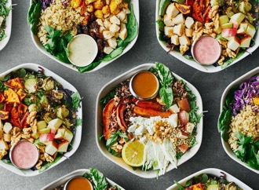
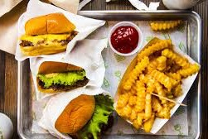
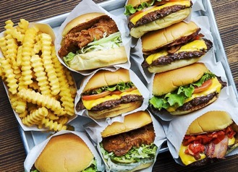
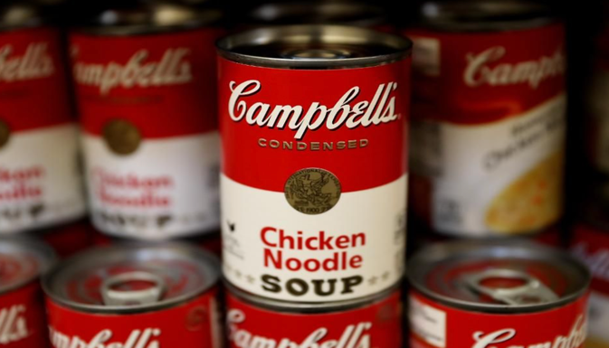
Categories Impacted:
All, Retail
Extreme Choices, Extreme Culture
We live in a world of extremes. These extremes play out through politics & popular culture, and the divided nature of our world is carrying over into brands, too. To combat the tension of people aren’t interested/lack of desire, we’ll see more brands occupying extremes, reducing the appeal of the middle.
Brand extremes exist across categories. From a QSR perspective, restaurants either offer super healthy options or deliver on indulgence. From a fashion perspective, you have the option of disposable clothing vs. luxury/investment goods.
COVID-19 Update: During the global Covid-19 pandemic we are observing a potential shift back to the middle as people focus on the basics and the brands they trust to help see them hrough this crisis. People for the most part aren’t panic-buying or stock-piling uber gourmet, or super healthy food at this time. They are largely stocking up on the basics for food, paper goods and cleaning products and mainstream FMCG products.
What will the decade ahead mean for the brands that occupy the middle? Time will tell whether after this crisis people return to being attracted to the extremes. Regardless, brands should consider how to put their stake in the ground and what territory they can authentically own. After all, any brand can be the “most” or “least” of something.
A tale of two fast-casual extremes: Burger joint Shake Shack and veggie-forward Sweet Greens both experienced rapid growth in 2019.
29%
Tension Spectrum: People aren’t interested in it
A staple in the US during the Covid-19 crisis, Campbell’s Soup stock is up 36% vs. last year at a time when the market is falling sharply.
Luxury is fastest growing category in top 100 global brands, with the sector increasing 29% in value in 2019.
Notes:
https://fashionunited.uk/news/fashion/luxury-is-fastest-growing-category-in-top-global-100-brands/2019061443674

Slide 11
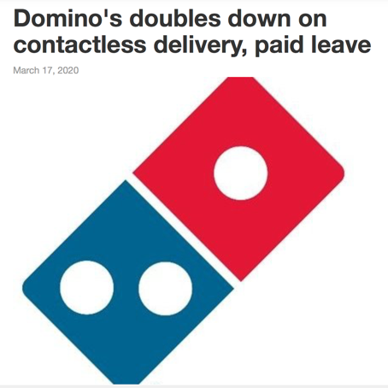
Categories Impacted:
Retail, CPG,
QSR
Green Pressure (lessens) & the Accelerating Expectation Gap
Across categories, expectations for brands has never been higher, and we will only see the expectation gap accelerate further in the decade ahead. People expect brands to deliver new product innovations and digital advertising magic, while also taking stances on critical issues and being a societal force for good. But people are questioning: is it good enough?
One area in particular where brands have been feeling this tension is around green pressure. With the ever growing climate crisis, consumers, investors and NGOs are pushing brands to take action and reduce their carbon footprint.
COVID-19 Update: The Coronavirus pandemic has lessened people’s attention on their own carbon footprint and brands’ commitment to the environment. We believe this is a short-term effect. Importantly, the current focus of the accelerating expectation gap is more about a rapid escalation of how companies are making and delivering their product to keep customers and employees safe during the global crisis.
As heightened expectations become the norm, and at the same time these expectations shift, brands will need to fluidly and adeptly stay ahead of the Expectation Gap. And consumers will reward you in sentiment and sales for meeting their increasing expectations.
The Greta Effect, named after climate change activist Greta Thunberg, has put pressure on brands.
84%
Tension Spectrum: People don’t think it’s good enough
of marketers who responded to a recent WARC study said ‘conscious’ consumerism and sustainability would impact their marketing strategies in 2020.
Notes:
https://www.warc.com/newsandopinion/news/the-greta-effect-puts-pressure-on-brands/43134
https://adage.com/creativity/work/burger-king-calling-kids-melt-down-their-plastic-meal-toys/2198176
https://www.ispot.tv/ad/oEF3/dominos-delivery-insurance

Slide 12
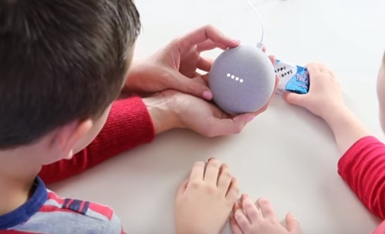
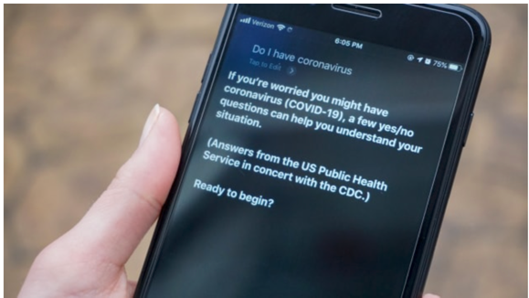
Categories Impacted:
QSR, Grocery
CPG,
Smart devices, Simple things
While the Alexa skills store has over 100,000 apps, the most popular thing to do with a smart speaker… is to listen to music. The capabilities of our technology is outpacing our ability to integrate them into our daily lives.
Only 28% of people use it to buy things. When they do, purchases are typically smaller things that someone could buy without necessarily having to see it physically.
People are generally OK with ordering detergent, but not a dress. And even with basic tasks, it can be frustrating when you ask Alexa to play music and she starts playing the wrong song.
COVID-19 Update: During the current Covid-19 crisis as people are homebound we are seeing and increased frequency of usage of smart speakers and a general flexing and expanding of how people are using their voice assisted devices including answering questions about the virus and even early diagnosis, and families looking educate and entertain young children.
This is a great moment for brands to get creative to motivate people to move beyond asking Alexa for the weather or to set a timer - providing practical, easy solutions for consumers to engage with connected devices.
Sticky hands & recipe book pages don’t go together, so Kellogg’s created a voice app to help families make Rice Krispie Treats
37%
Tension Spectrum: It doesn’t do what people want it to
of people who are dissatisfied with their device say it’s because ”it’s not as helpful as I thought it would be.”
Apple has updated Siri to help people determine if they have the Coronavirus.
Notes:
https://www.statista.com/topics/2430/smart-homes/ - $53 Billion
https://www.usatoday.com/story/tech/2018/05/02/almost-20-percent-americans-use-smart-speakers-such-amazon-echo-google-home/573555002/ - most common: play music. 28% buy.
https://venturebeat.com/2019/09/25/the-alexa-skills-store-now-has-more-than-100000-voice-apps/ - 100,000 apps
https://www.pwc.com/us/en/industry/entertainment-media/publications/consumer-intelligence-series/assets/pwc-consumer-intelligence-series-iot-connected-home.pdf – 37% of dissatisfied users cite “its not as helpful as they thought it would be:”

Slide 13
TENSION
Strong Risk of Heightened Tension Between People and Brands
Notes:
B

Slide 14
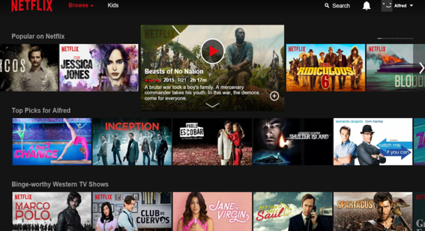
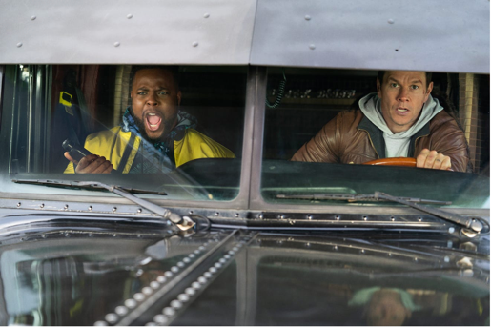
Categories Impacted:
Entertainment, Beverages,
Gaming, All
Achieving Scale in Our Fragmented World
While TV has historically been the primary channel to create mass awareness, today’s video landscape is highly-fragmented making it even harder for brands to combat a common tension: people don’t know about it/lack of awareness.
There is so much content surrounding people today that even curation algorithms aren’t enough to help people filter. Younger generations are discovering shows through the memes they spawn in their social feeds. And, with the quality and quantity of programming across Netflix, Hulu, Disney+ and others, it seems like everything and nothing is simultaneously “must see TV.”
COVID-19 Update: The coronavirus pandemic is having a huge impact on the video landscape. On the one hand, people are streaming more content than ever before as the seek in-home entertainment which has been a huge boon for streaming services such as Netflix. On the other hand, many of the content “moments” that created scale in video before such as sports, concerts, and live events are currently unavailable so the challenge in reaching mainstream audiences at scale remains.
Services like Flixable enable users to search shows across platforms based on type, topics, rating/popularity and more.
64%
Tension Spectrum: People don’t know about it
People who intend to subscribe to a new video entrant said they would downgrade or terminate one of their current video services to do so.
According to Neilsen, the number of minutes the average person spent streaming TV and movies has jumped 36% since the end of February.
Notes:
64% pwc study https://www.pwc.com/us/en/services/consulting/library/consumer-intelligence-series/consumer-video-streaming-behavior.html
TV critic strategy on content consumption: https://www.hollywoodreporter.com/live-feed/welcome-age-background-tv-1205588

Slide 15
Categories Impacted:
CPG, Retail
Health & Beauty
DTC Changing the Price-Value Equation
The rise of e-commerce, the shuttering of traditional brick and mortar and the rise of direct-to-consumer (DTC) brands will continue to be major forces of change impacting how people shop in 2020 and beyond. But more than that, it will continue to dynamically shift the price-value equation for people and brands.
Value is a common tension for consumers when making purchasing decisions (“it’s not worth the price.”). The rise of DTC brands has helped lessen this tension for people, but has increased that tension exponentially for brands.
Competition within the DTC space has created new challenges for brands, as each attempt to win on price. With pricing models continuing to be dynamic and with an always seemingly cheaper option available, brands need to consider how to build loyalty through product satisfaction and experiences of value.
COVID-19 Update: The Covid-19 crisis has both positive and negative impact on DTC brands. On a positive note, as people are forced to avoid brick-and-mortar retail, e:commerce and DTC brands specifically are helping to create value and fill needs. However, as large fulfillment platforms like Amazon are forced to slow down deliveries due to strained capacity, small DTC brands can suffer the most.
In 2019, there were nearly a dozen DTC bedding companies alone each competing on product and cost.
$8B by 2024
Tension Spectrum: It’s not worth the price
Retail and CPG brands are expected to invest approximately $8B in artificial intelligence by 2024 to manage demand, pricing, and optimize consumer experience
Amazon to temporarily stop shipping non-essential products in Italy and France
Notes:
Source: https://www.shopify.com/enterprise/direct-to-consumer-ecommerce
https://www.mytotalretail.com/article/online-price-wars-what-you-can-do-to-avoid-a-race-to-the-bottom/
https://towardsdatascience.com/how-artificial-intelligence-and-machine-learning-assist-retailers-and-consumers-6290717da14e

Slide 16
Categories Impacted:
CPG, Tobacco, Alcohol, All
Shifting Landscape, Shifting Vices
With an abundance of choice at their fingertips, people always want to try something new. This tension creates challenges for brands as they attempt to keep pace with shifting consumer preferences. We’re seeing this occur in the rapidly changing beverage sector where new ways to imbibe are creating new vices for people and novelty-seeking behavior.
Today people are rapidly exploring across vices – from new forms of alcohol to destigmatized newly-legalized cannabis. New healthcare classified CBD products & curiosity about emerging micro-dosing of psychedelics are bringing unexpected explorers to categories.
For marketers, there is undeniably opportunity here, but it’s a complex landscape to navigate, particularly at this sensitive time. People’s rapidly evolving behavior across vices is difficult to follow, much less predict. And regulatory uncertainty is a challenge for brands looking to enter the space.
COVID-19 Update: All evidence shows that the current pandemic is causing a huge surge in “vice” consumption as people stockpile alcohol and try CBD and hemp products for the first time to try to soothe anxiety and relieve stress.
Recreational marijuana sold $13B in 2019
-15%
Tension Spectrum: People want to try something new
Decrease in wine/beer sales in legal marijuana markets (USA)
Alcohol stores across Australia are putting limits on the amount of liquor customers can buy in one transaction, in a bid to prevent panic buying during the coronavirus outbreak.
Notes:
https://www.marketwatch.com/story/millennials-appear-to-like-cannabis-more-than-booze-2018-09-26
https://markets.businessinsider.com/news/stocks/beer-companies-stocks-best-for-hard-seltzer-boom-ubs-2019-7-1028400172
https://mjbizdaily.com/exclusive-us-retail-marijuana-sales-on-pace-to-rise-35-in-2019-and-near-30-billion-by-2023/

Slide 17
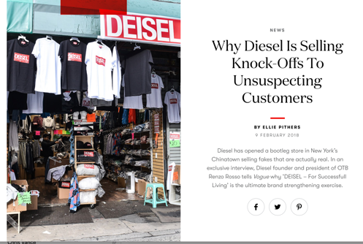
Categories Impacted:
All, Fashion, QSR, Media
Fake Will Continue to Flourish
It used to be easy to know what was fake. Bigfoot sightings, a headline in the National Enquirer or maybe a propaganda strewn self-published magazine didn’t fool many.
Today, “fake” is an ever present part of the human experience. Fake news is causing us to question mainstream media. Purchaseable social likes, fake clicks and bots are confusing measurement plans and destroying payment models.
COVID-19 Update: As the Covid-19 crisis unfolds we are unfortunately seeing more disinformation than ever before. People’s usage of social media is sharply up, however many of the largest platforms can’t support moderation staff at this time and are shifting to AI moderation which is less accurate, meaning more fake news than ever is being circulated.
Brands can thrive in this new territory by: Embracing the fakes, making fake things real (DEISEL). Or helping people to battle the fakes (New Zealand’s NetSafe and the Jolly Roger Phone app.) But brands beware, and especially now. Skepticism is high in a world where everything can be a fake, and especially during a time of great crisis.
Diesel brand created a line of fake clothing to playfully combat counterfeit fashion brands.
$1.3B
Tension Spectrum: People don’t believe it
Fake followers cost brands $1.3B in 2019 alone
Social media is full of BOTS spreading falsehoods about the Coronavirus.
Notes:
https://www.edelman.com/research/2019-edelman-trust-barometer
https://www.edelman.com/sites/g/files/aatuss191/files/2019-03/2019_Edelman_Trust_Barometer_Global_Report.pdf?utm_source=website&utm_medium=global_report&utm_campaign=downloads
https://digiday.com/media/global-state-trust-media-5-charts/
https://www.wired.com/story/instagram-fake-followers/

Slide 18
The Human Experience Company
18

